Slide 1
GalaxSE System
CZ3003 SSAD
A social game for the teaching and learning of Software Engineering
Team SpaceGO

Slide 2
TABLE OF CONTENTS
01
04
02
05
03
06
07
CZ3003 SSAD
About GalaxSE
Non-Functional Requirement
Project Basic Requirements
Architecture and Design
Functional Requirement
Tech Stack
Demo!

Slide 3
About the Game
GalaxSE System consists of a desktop game application (GalaxSE Game) and a web application (Teacher WebApp)
GalaxSE Game: teaching and learning of Software Engineering courses through a gamified and socialized approach
Teachers WebApp: provides convenience to teachers through its analysis tool and assignments feature. It allows teachers to manage and test their students through custom-made assignments
GalaxSE System
GalaxSE Game
Teachers WebApp

Slide 4


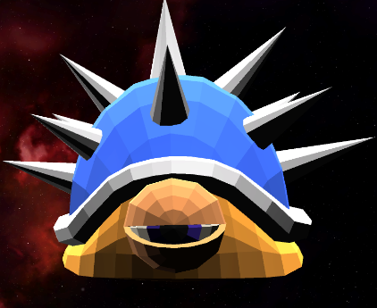
Requirements
Theme
Space Theme
Worlds
Galaxy
Characters
Astronauts
Sections
Planets
Leaderboard
Total Score of Explore Solo Mission game mode
Levels
Monsters

Slide 5
Requirements
GalaxSE Game
Questions will be chosen using machine learning based on the student’s past performance
Subsequent questions will be chosen through adaptive learning.
Real Time Analysis
Machine Learning
Data Analysis
Summary Report
Data Analytics
Teachers WebApp
View lab groups total score
View individual student progress and mastery
View Summary Report for each Galaxy

Slide 6
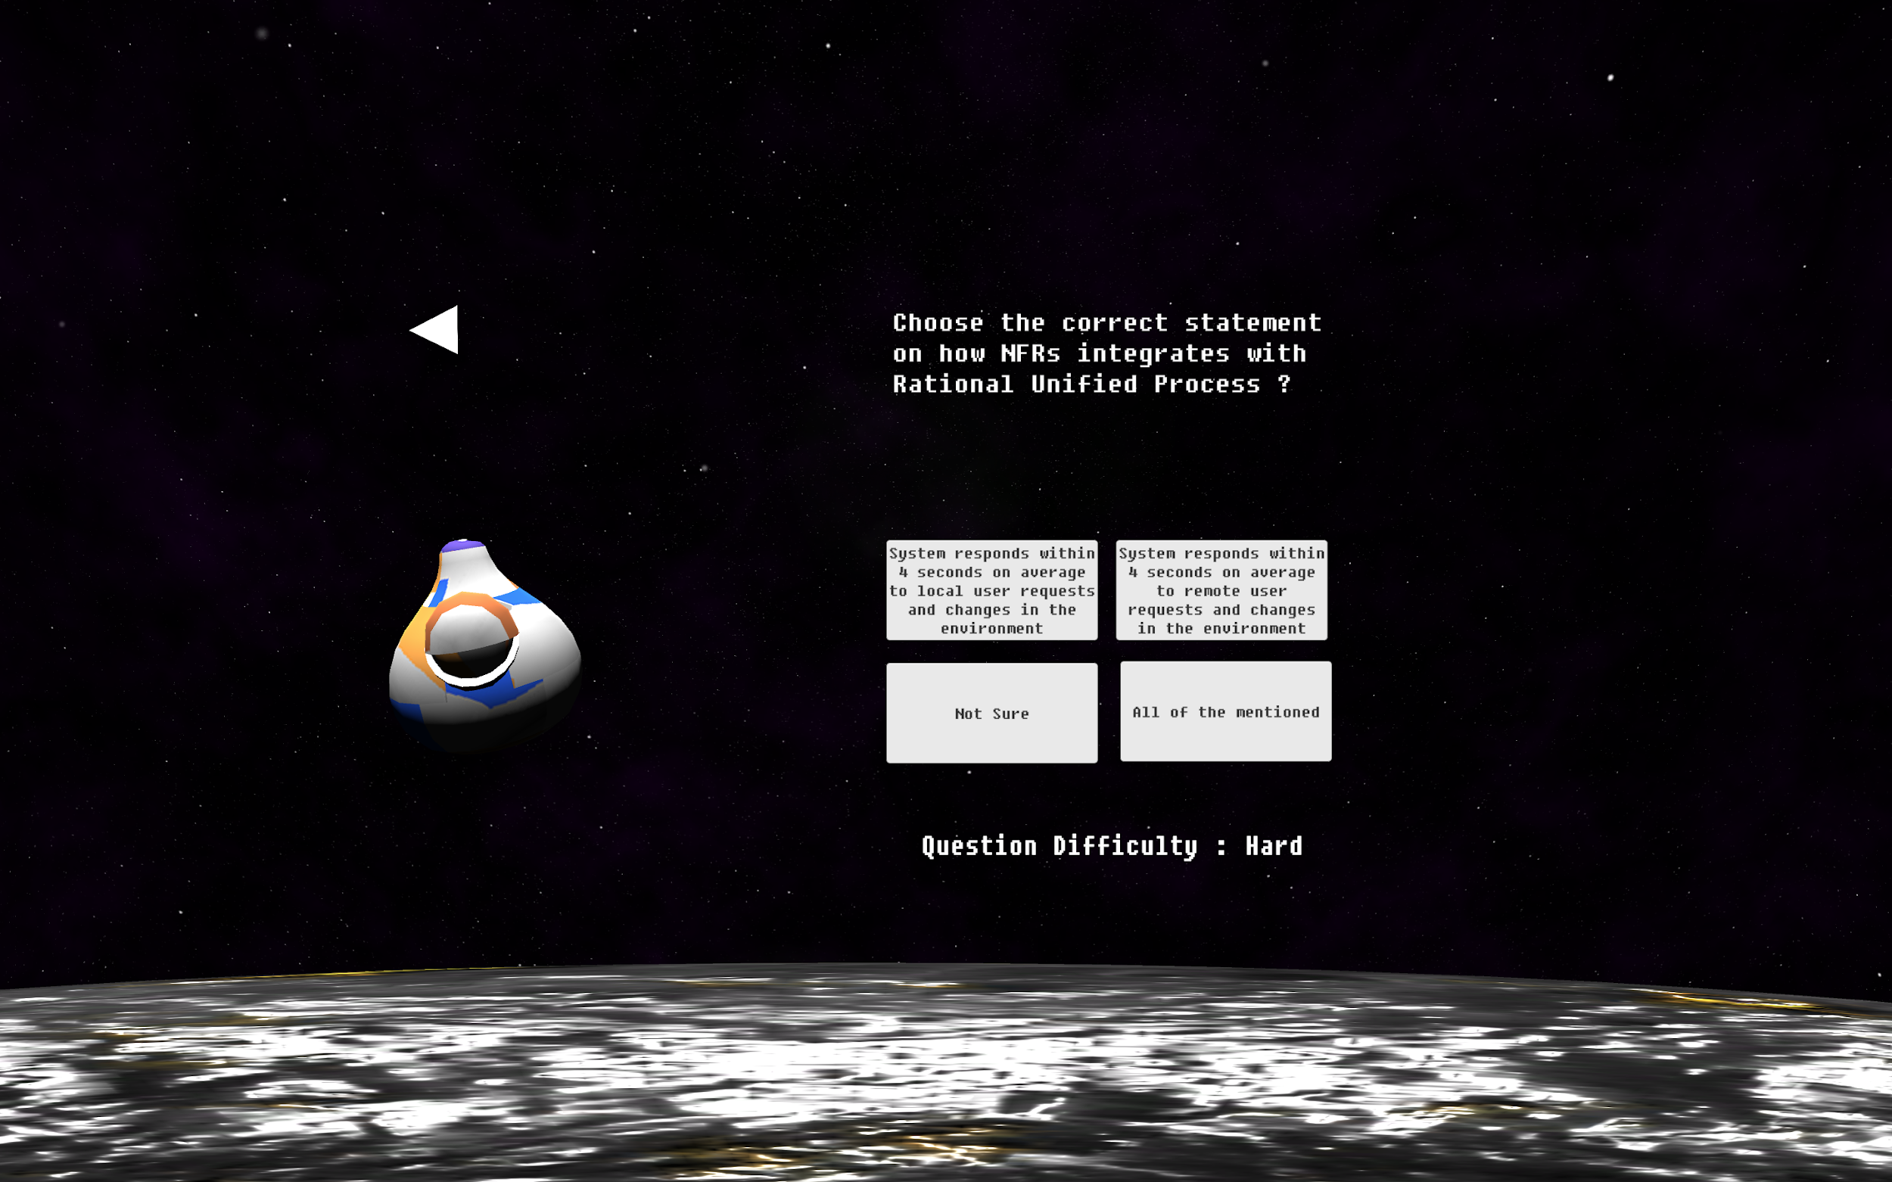
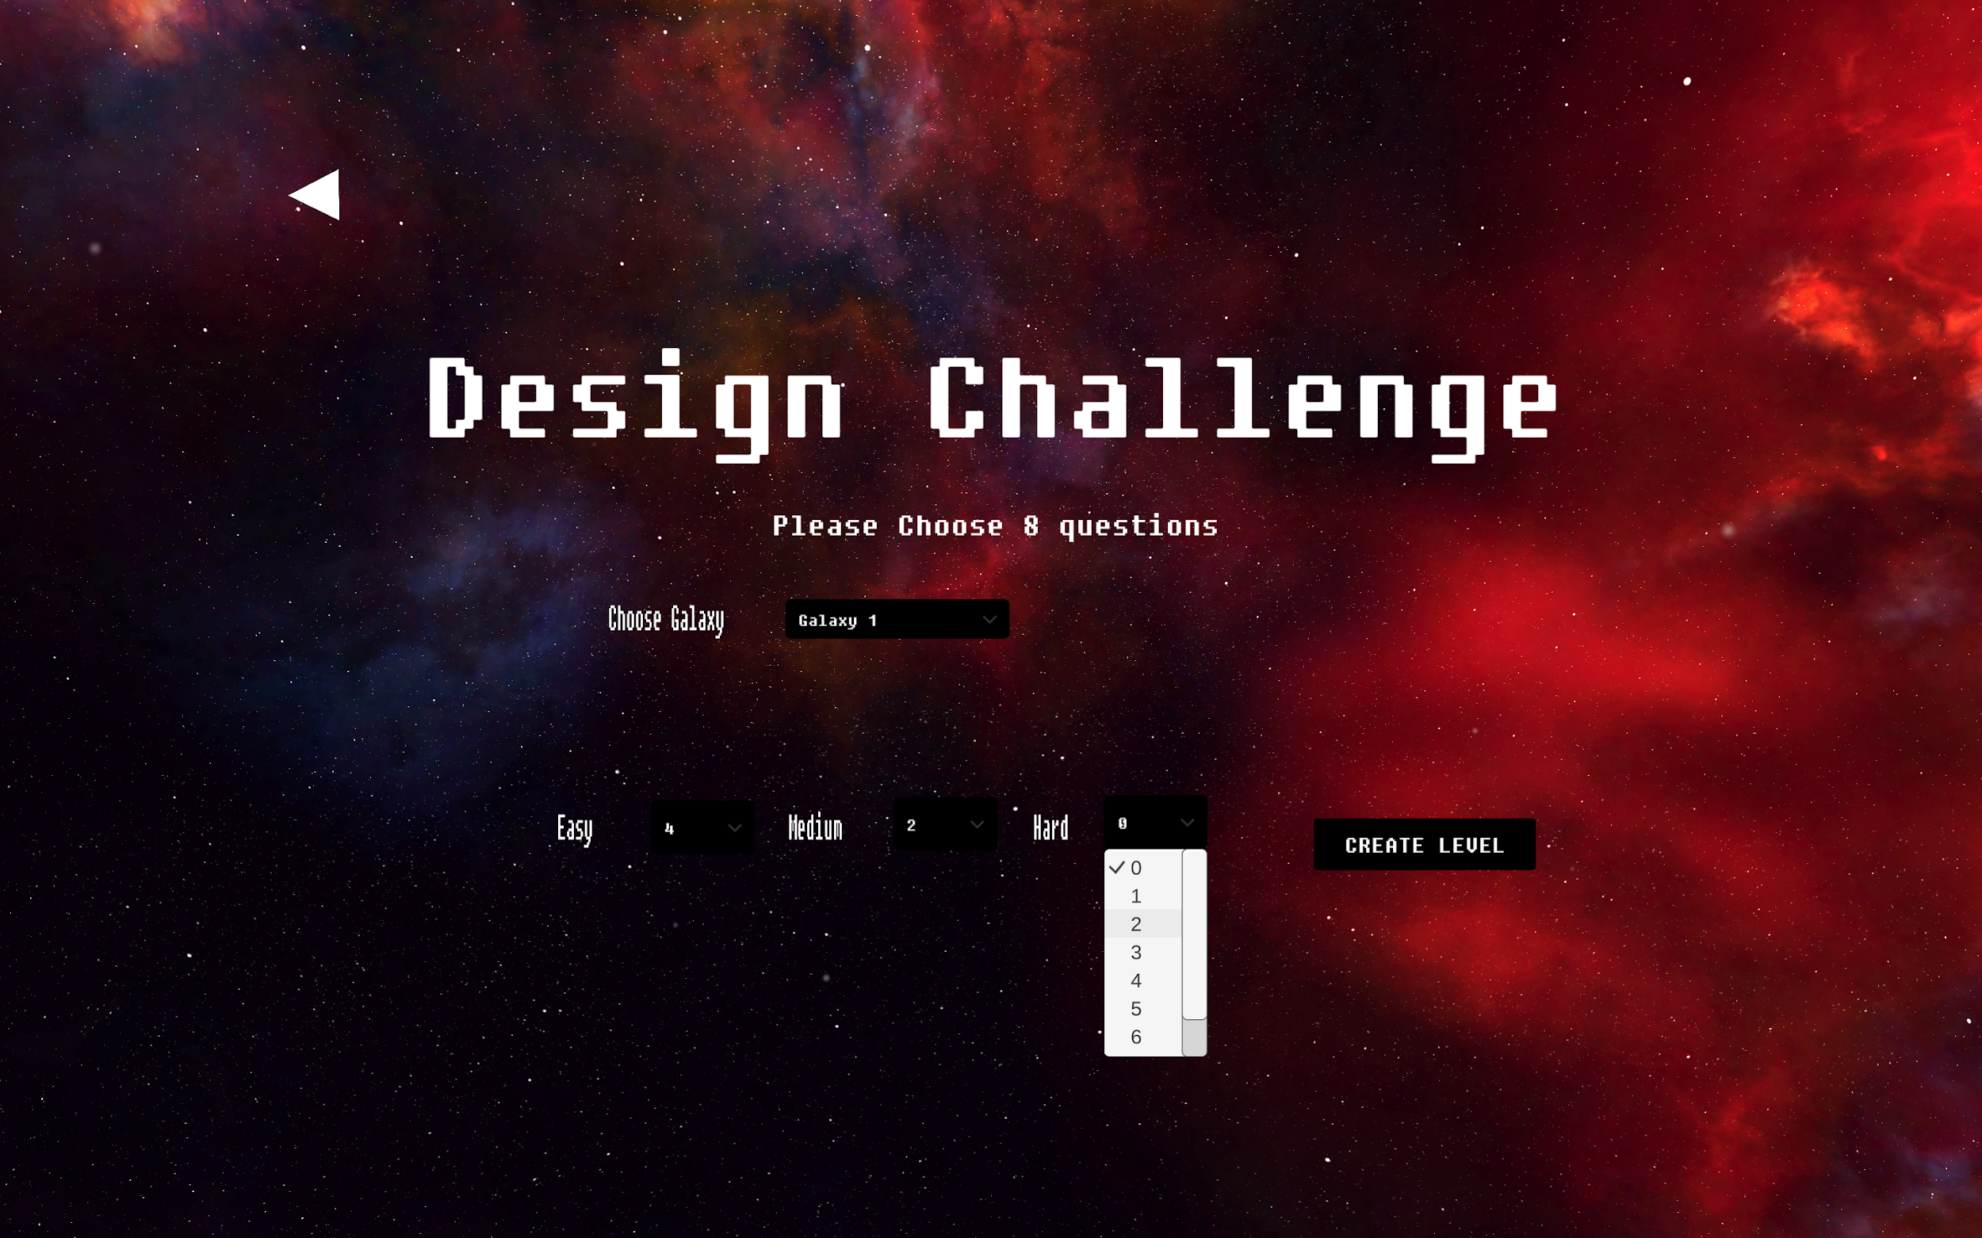
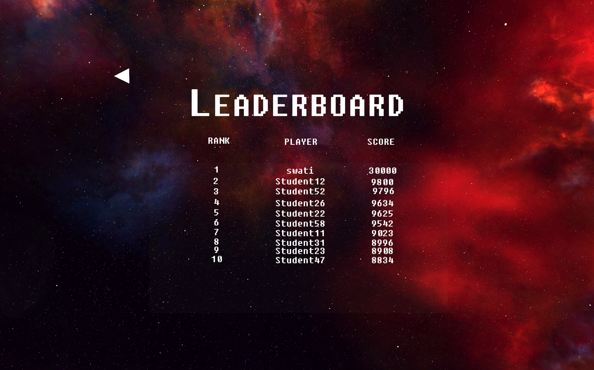
GalaxSE Game
The game will have 3 different modes: Explore Solo Mission, Challenges & Assignments
Students can Create Challenge Monster and share them with other students using Social Media (Twitter & Reddit)
Leaderboard shows the Overall Ranking of Students for Explore Solo Mission mode.

Slide 7
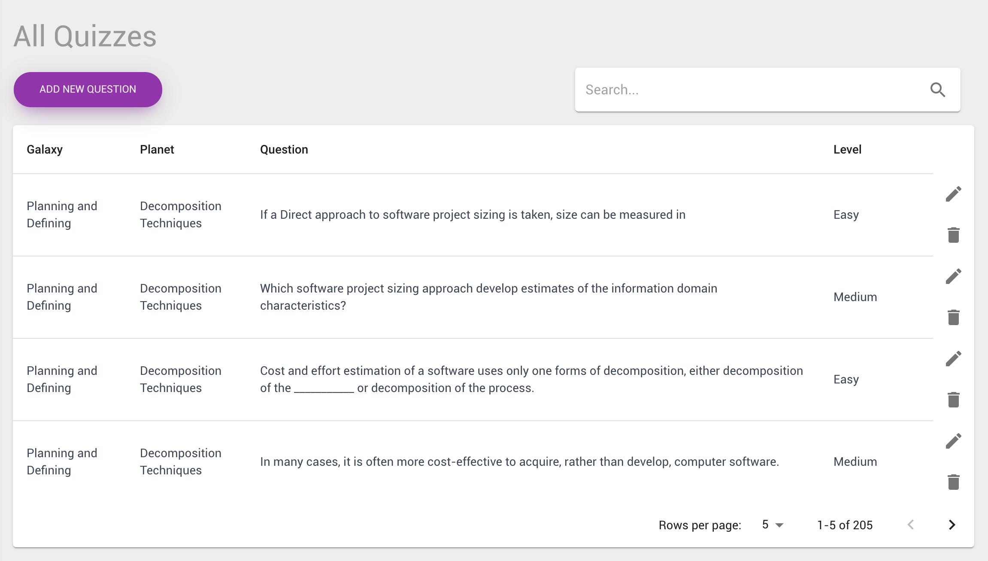
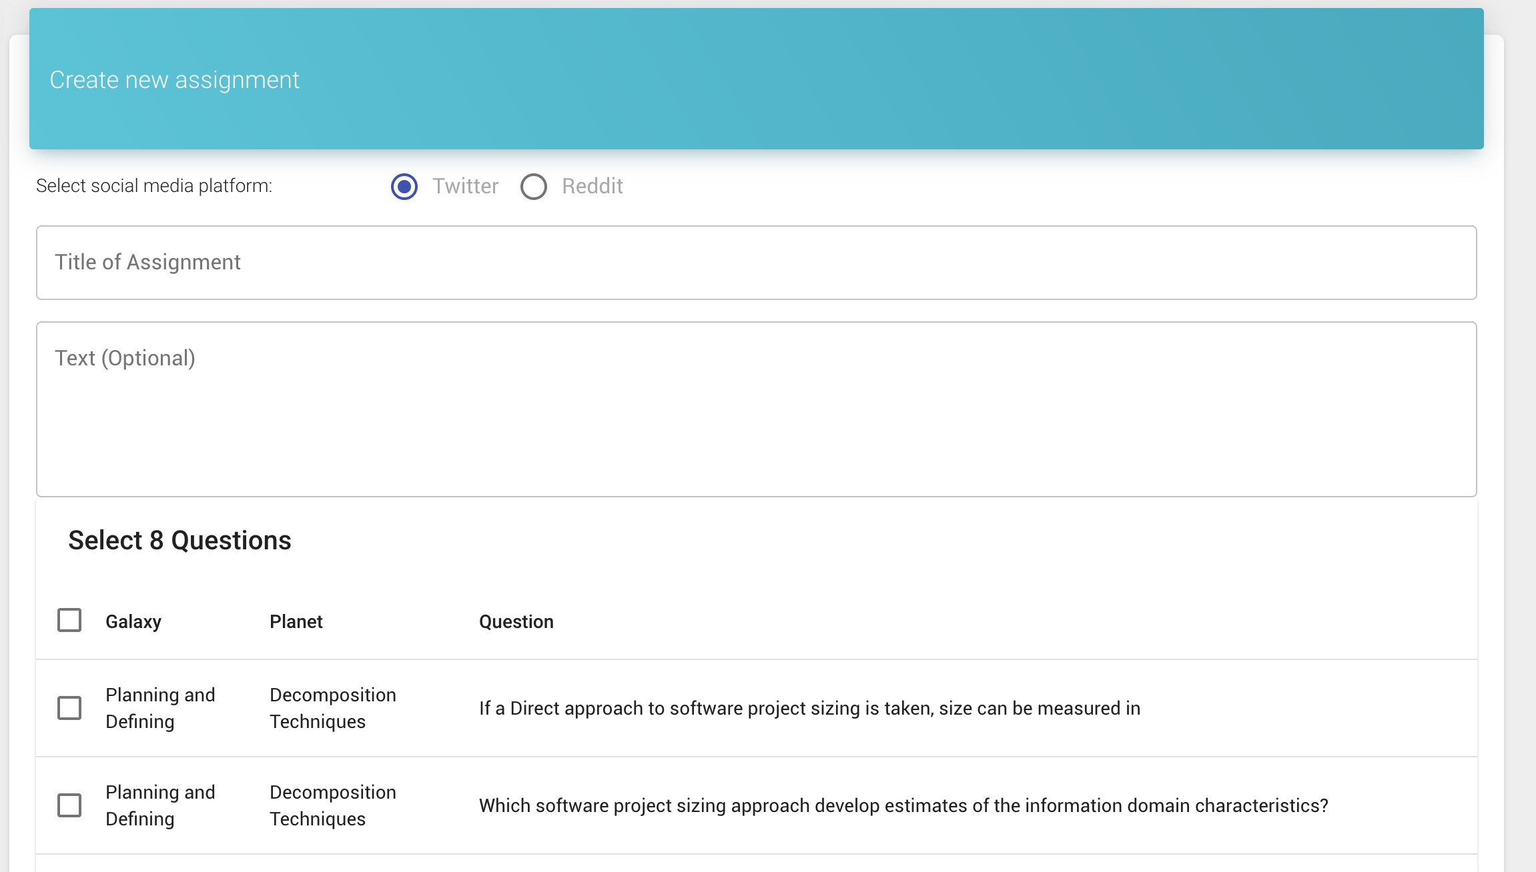
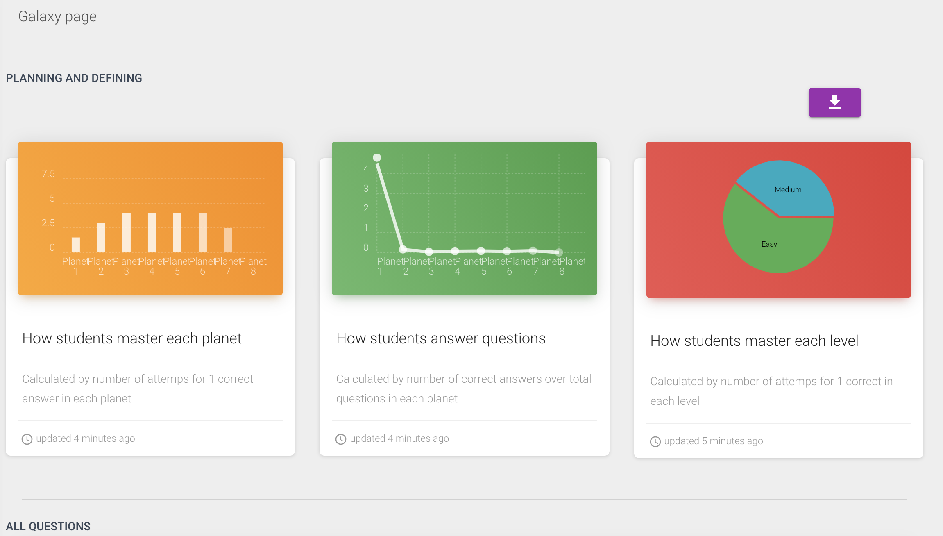
Teachers WebApp
Edit the Question Bank (add, edit, remove)
Teachers can Create and Send Assignments to students using Social Media (Twitter & Reddit)
View Analytics for individual students, lab groups and teaching content

Slide 8
Functional Requirements (GalaxSE Game)
Account Management
User Status
Login GalaxSE Game
Create Challenge Monster
GalaxSE Gameplay
Complete Challenge & Assignment
Explore Solo MIssion

Slide 9
Functional Requirements (Teacher WebApp)
Teacher WebApp
Create Assignment
View Summary Report
Learning Video
Edit Question Bank

Slide 10
Non Functional Requirements
Maintainability
Separate Systems
Edit the Game
Easy to change game content by changing the question bank or the database. Tutorial videos can be changed easily if the content is outdated.
The GalaxSE system is split into 2 separate component. We will be able to develop both system independently and faults in each system will not affect the functional requirements of other individual Components

Slide 11
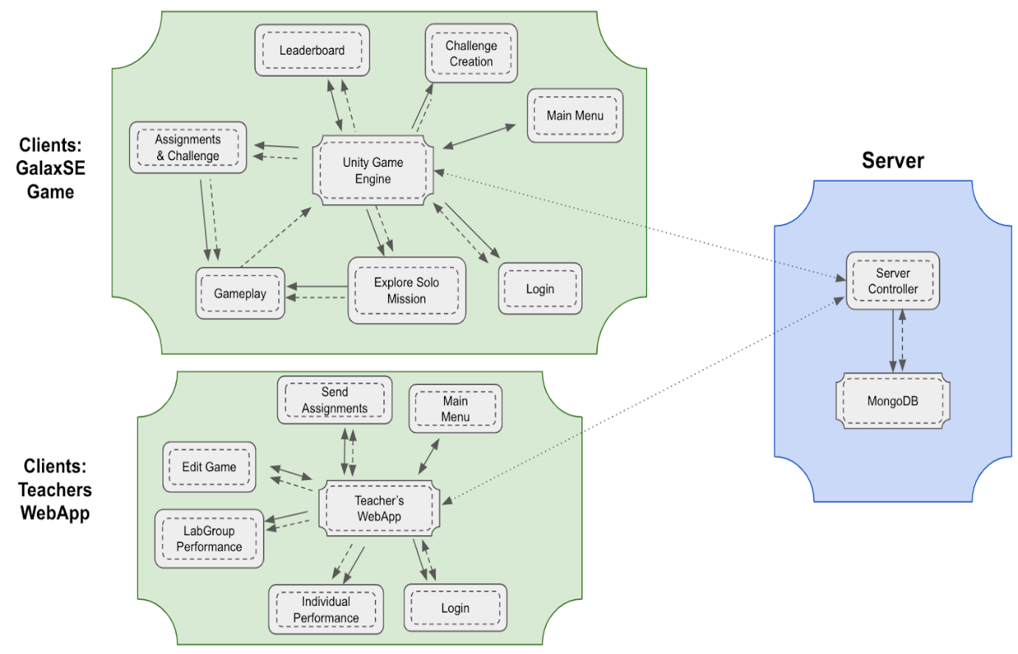
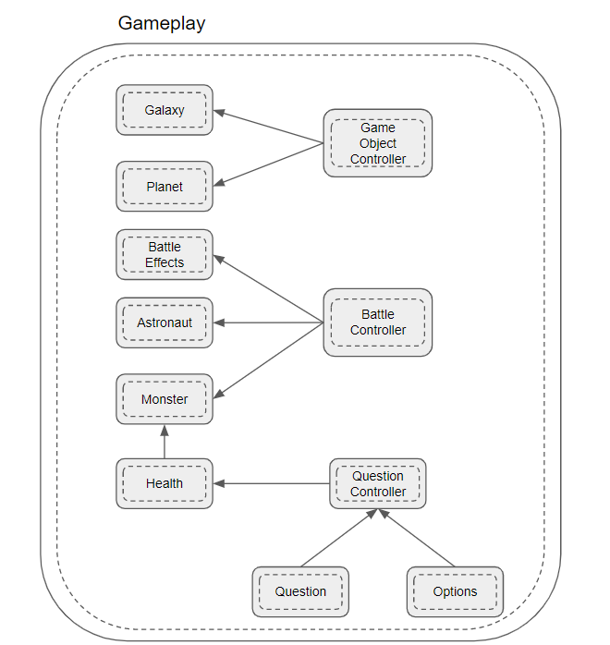
Architecture Design
Hierarchically Heterogeneous Architecture Style that uses Client & Server as our primary candidate architecture and Entity Component as our subsystem architecture.

Slide 12





Tech Stack
Unity
ReactJS
MongoDB
Twitter
Reddit

Slide 13
Demonstration!

Slide 14
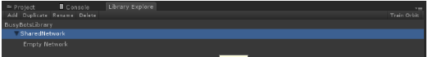
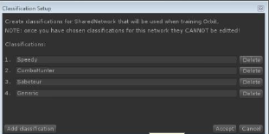
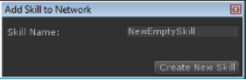
Machine Learning Implementation
Library
Network
Skills

Slide 15
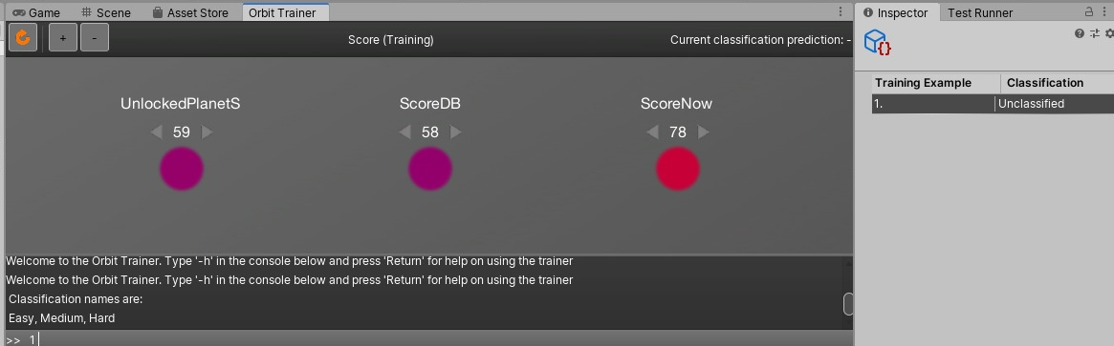

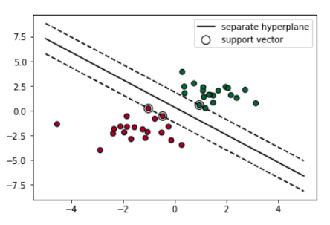
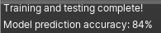

Slide 16
Thank You

